Slide 1
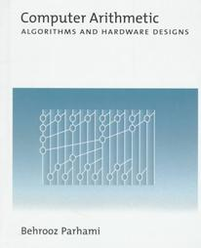
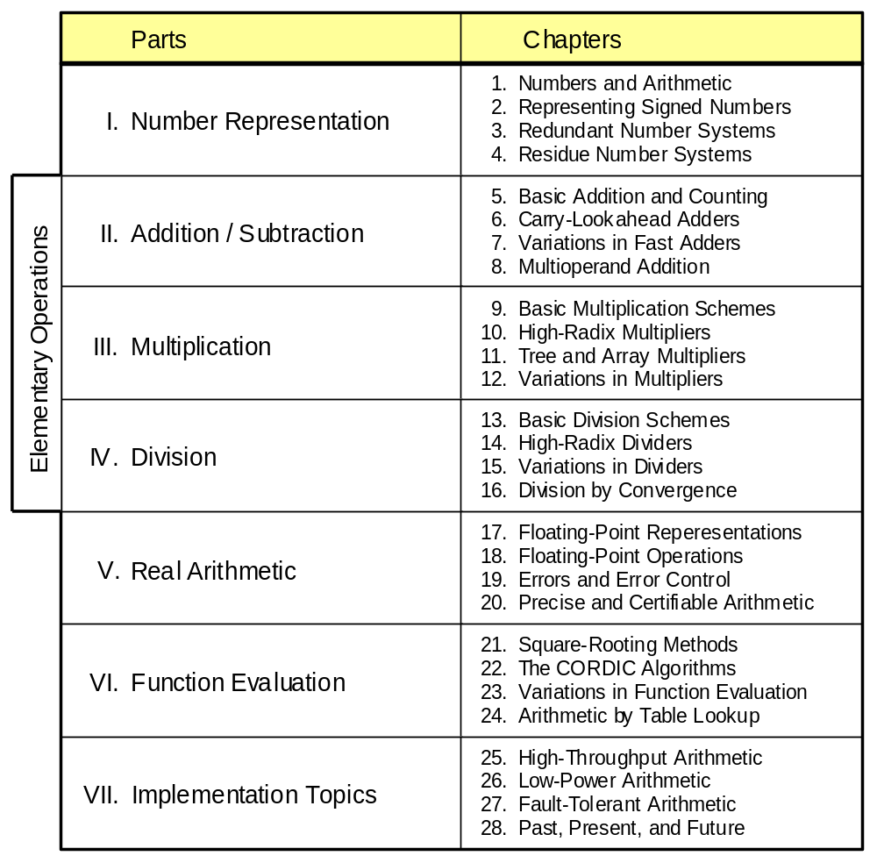
Part I
Number Representation

Slide 2
About This Presentation
This presentation is intended to support the use of the textbook Computer Arithmetic: Algorithms and Hardware Designs (Oxford University Press, 2000, ISBN 0-19-512583-5). It is updated regularly by the author as part of his teaching of the graduate course ECE 252B, Computer Arithmetic, at the University of California, Santa Barbara. Instructors can use these slides freely in classroom teaching and for other educational purposes. Unauthorized uses are strictly prohibited. © Behrooz Parhami
Edition | Released | Revised | Revised | Revised | Revised
First | Jan. 2000 | Sep. 2001 | Sep. 2003 | Sep. 2005 | Apr. 2007

Slide 3
I Background and Motivation
Number representation arguably the most important topic:
  Effects on system compatibility and ease of arithmetic
  2’s-complement, redundant, residue number systems
  Limits of fast arithmetic
  Floating-point numbers to be covered in Chapter 17
Topics in This Part
Chapter 1 Numbers and Arithmetic
Chapter 2 Representing Signed Numbers
Chapter 3 Redundant Number Systems
Chapter 4 Residue Number Systems

Slide 4
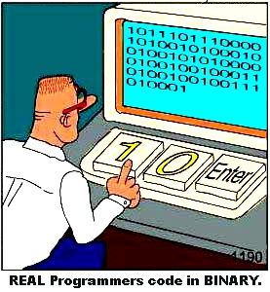
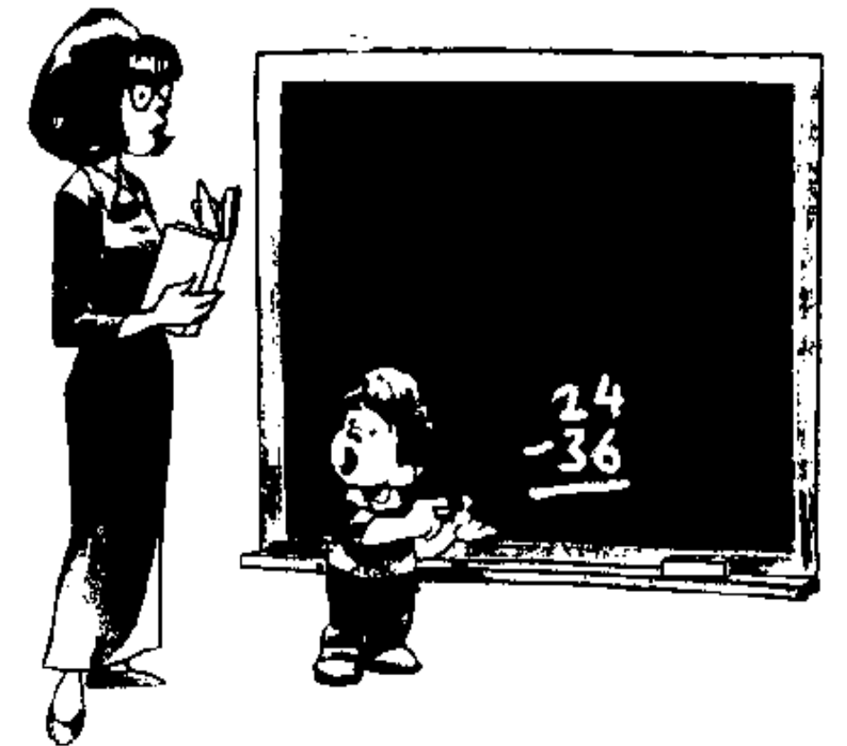
“This can’t be right . . . It goes into the red!”

Slide 5
1 Numbers and Arithmetic
Chapter Goals
Define scope and provide motivation
Set the framework for the rest of the book
Review positional fixed-point numbers
Chapter Highlights
What goes on inside your calculator?
Ways of encoding numbers in k bits
Radices and digit sets: conventional, exotic
Conversion from one system to another

Slide 6
Numbers and Arithmetic: Topics
Topics in This Chapter
1.1. What is Computer Arithmetic?
1.2. A Motivating Example
1.3. Numbers and Their Encodings
1.4. Fixed-Radix Positional Number Systems
1.5. Number Radix Conversion
1.6. Classes of Number Representations

Slide 7
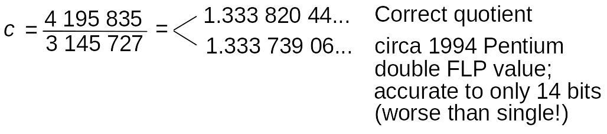
1.1 What is Computer Arithmetic?
Pentium Division Bug (1994-95): Pentium’s radix-4 SRT algorithm occasionally gave incorrect quotient
First noted in 1994 by T. Nicely who computed sums of reciprocals of twin primes:
1/5 + 1/7 + 1/11 + 1/13 + . . . + 1/p + 1/(p + 2) + . . .
Worst-case example of division error in Pentium:

Slide 8
Top Ten Intel Slogans for the Pentium
Humor, circa 1995
9.999 997 325 It’s a FLAW, dammit, not a bug
8.999 916 336 It’s close enough, we say so
7.999 941 461 Nearly 300 correct opcodes
6.999 983 153 You don’t need to know what’s inside
5.999 983 513 Redefining the PC –– and math as well
4.999 999 902 We fixed it, really
3.999 824 591 Division considered harmful
2.999 152 361 Why do you think it’s called “floating” point?
1.999 910 351 We’re looking for a few good flaws
0.999 999 999 The errata inside

Slide 9
Aspects of, and Topics in, Computer Arithmetic
Hardware (our focus in this book) Software
––––––––––––––––––––––––––––––––––––––––––––––––– ––––––––––––––––––––––––––––––––––––
Design of efficient digital circuits for Numerical methods for solving
primitive and other arithmetic operations systems of linear equations,
such as +, –, ×, ÷, √, log, sin, cos partial differential equations, etc.
Issues: Algorithms Issues: Algorithms
Error analysis Error analysis
Speed/cost trade-offs Computational complexity
Hardware implementation Programming
Testing, verification Testing, verification
General-purpose Special-purpose
–––––––––––––––––––––– –––––––––––––––––––––––
Flexible data paths Tailored to
Fast primitive applications like:
operations like Digital filtering
+, –, ×, ÷, √ Image processing
Benchmarking Radar tracking
Fig. 1.1 The scope of computer arithmetic.

Slide 10
1.2 A Motivating Example
Using a calculator with √, x², and x^{y} functions, compute:
u = √√ … √ 2 = 1.000 677 131 “1024th root of 2”
v = 2^{1/1024} = 1.000 677 131
Save u and v; If you can’t save, recompute values when needed
x = (((u²)²)...)² = 1.999 999 963
x' = u¹⁰²⁴ = 1.999 999 973
y = (((v²)²)...)² = 1.999 999 983
y' = v¹⁰²⁴ = 1.999 999 994
Perhaps v and u are not really the same value
w = v – u = 1 × 10^{–11} Nonzero due to hidden digits
(u – 1) × 1000 = 0.677 130 680 [Hidden ... (0) 68]
(v – 1) × 1000 = 0.677 130 690 [Hidden ... (0) 69]

Slide 11
Finite Precision Can Lead to Disaster
Example: Failure of Patriot Missile (1991 Feb. 25)
Source http://www.math.psu.edu/dna/455.f96/disasters.html
American Patriot Missile battery in Dharan, Saudi Arabia, failed to intercept incoming Iraqi Scud missile
The Scud struck an American Army barracks, killing 28
Cause, per GAO/IMTEC-92-26 report: “software problem” (inaccurate calculation of the time since boot)
Problem specifics:
Time in tenths of second as measured by the system’s internal clock was multiplied by 1/10 to get the time in seconds
Internal registers were 24 bits wide
1/10 = 0.0001 1001 1001 1001 1001 100 (chopped to 24 b)
Error ≈ 0.1100 1100 × 2^{–23} ≈ 9.5 × 10^{–8}
Error in 100-hr operation period
≈ 9.5 × 10 –8 × 100 × 60 × 60 × 10 = 0.34 s
Distance traveled by Scud = (0.34 s) × (1676 m/s) ≈ 570 m

Slide 12
Finite Range Can Lead to Disaster
Example: Explosion of Ariane Rocket (1996 June 4)
Source http://www.math.psu.edu/dna/455.f96/disasters.html
Unmanned Ariane 5 rocket of the European Space Agency veered off its flight path, broke up, and exploded only 30 s after lift-off (altitude of 3700 m)
The $500 million rocket (with cargo) was on its first voyage after a decade of development costing $7 billion
Cause: “software error in the inertial reference system”
Problem specifics:
A 64 bit floating point number relating to the horizontal velocity of the rocket was being converted to a 16 bit signed integer
An SRI* software exception arose during conversion because the 64-bit floating point number had a value greater than what could be represented by a 16-bit signed integer (max 32 767)
*SRI = Système de Référence Inertielle or Inertial Reference System

Slide 13
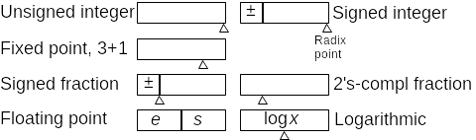
1.3 Numbers and Their Encodings
Some 4-bit number representation formats
Exponent in
{−2, −1, 0, 1}
Significand in
{0, 1, 2, 3}
Base-2
logarithm

Slide 14
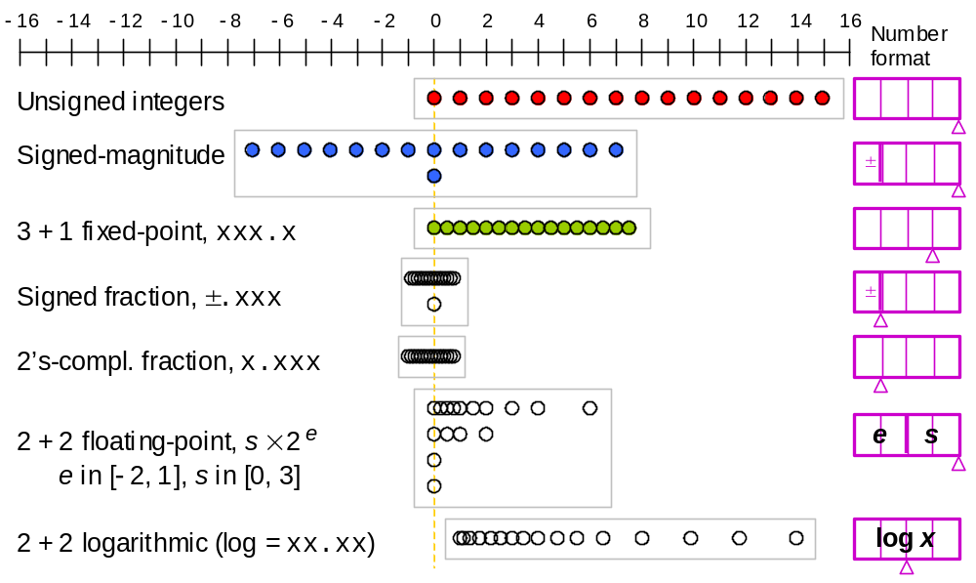
Encoding Numbers in 4 Bits
Fig. 1.2 Some of the possible ways of assigning 16 distinct codes to represent numbers.

Slide 15
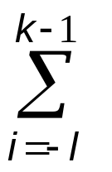
1.4 Fixed-Radix Positional Number Systems
( x_{k–1}x_{k–2} . . . x₁x₀ . x_{–1}x_{–2} . . . x_{–l} )_{r} = x_{i} r ^{i}
One can generalize to:
Arbitrary radix (not necessarily integer, positive, constant)
Arbitrary digit set, usually {–α, –α+1, . . . , β–1, β} = [–α, β]
Example 1.1. Balanced ternary number system:
Radix r = 3, digit set = [–1, 1]
Example 1.2. Negative-radix number systems:
Radix –r, r ≥ 2, digit set = [0, r – 1]
The special case with radix –2 and digit set [0, 1]
is known as the negabinary number system

Slide 16
More Examples of Number Systems
Example 1.3. Digit set [–4, 5] for r = 10:
(3 –1 5)ten represents 295 = 300 – 10 + 5
Example 1.4. Digit set [–7, 7] for r = 10:
(3 –1 5)ten = (3 0 –5)ten = (1 –7 0 –5)ten
Example 1.7. Quater-imaginary number system:
radix r = 2j, digit set [0, 3]

Slide 17
1.5 Number Radix Conversion
Whole part
Fractional part
u = w . v
= ( x_{k–1}x_{k–2} . . . x₁x₀ . x_{–1}x_{–2} . . . x_{–l} )_{r} Old
= ( X_{K–1}X_{K–2} . . . X₁X₀ . X_{–1}X_{–2} . . . X_{–L} )_{R} New
Example: (31)_{eight} = (25)_{ten} 31 Oct. = 25 Dec. Halloween = Xmas
Radix conversion, using arithmetic in the old radix r
Convenient when converting from r = 10
Radix conversion, using arithmetic in the new radix R
Convenient when converting to R = 10

Slide 18
Radix Conversion: Old-Radix Arithmetic
Converting whole part w: (105)_{ten} = (?)_{five}
Repeatedly divide by five Quotient Remainder
105 0
21 1
4 4
0
Therefore, (105)_{ten} = (410)_{five}
Converting fractional part v: (105.486)_{ten} = (410.?)_{five}
Repeatedly multiply by five Whole Part Fraction .486
2 .430
2 .150
0 .750
3 .750
3 .750
Therefore, (105.486)_{ten} ≅ (410.22033)_{five}

Slide 19
Radix Conversion: New-Radix Arithmetic
Converting whole part w: (22033)_{five} = (?)_{ten}
((((2 × 5) + 2) × 5 + 0) × 5 + 3) × 5 + 3
|-----| : : : :
10 : : : :
|-----------| : : :
12 : : :
|---------------------| : :
60 : :
|-------------------------------| :
_{303 :}
|-----------------------------------------|
₁₅₁₈
Horner’s
rule or
formula
Converting fractional part v: (410.22033)_{five} = (105.?)_{ten}
(0.22033)_{five} × 5⁵ = (22033)_{five} = (1518)_{ten}
1518 / 5⁵ = 1518 / 3125 = 0.48576
Therefore, (410.22033)_{five} = (105.48576)_{ten}
Horner’s rule is also applicable: Proceed from right to left and use division instead of multiplication

Slide 20
Horner’s Rule for Fractions
Converting fractional part v: (0.22033)_{five} = (?)_{ten}
(((((3 / 5) + 3) / 5 + 0) / 5 + 2) / 5 + 2) / 5
|-----| : : : :
0.6 : : : :
|-----------| : : :
3.6 : : :
|---------------------| : :
0.72 : :
|-------------------------------| :
_{2.144 :}
|-----------------------------------------|
_{2.4288}
|-----------------------------------------------|
_{0.48576}
Horner’s
rule or
formula
Fig. 1.3 Horner’s rule used to convert (0.220 33)five to decimal.

Slide 21
1.6 Classes of Number Representations
Integers (fixed-point), unsigned: Chapter 1
Integers (fixed-point), signed
Signed-magnitude, biased, complement: Chapter 2
Signed-digit, including carry/borrow-save: Chapter 3
(but the key point of Chapter 3 is
using redundancy for faster arithmetic,
not how to represent signed values)
Residue number system: Chapter 4
(again, the key to Chapter 4 is
use of parallelism for faster arithmetic,
not how to represent signed values)
For the most part you need:
− The 2’s complement format
− Carry-save representation
− ANSI/IEEE FLP format
However, knowing the rest of the material (including RNS) provides you with more options when designing custom and special-purpose hardware systems
Real numbers, floating-point: Chapter 17
Part V deals with real arithmetic
Real numbers, exact: Chapter 20
Continued-fraction, slash, . . .

Slide 22
2 Representing Signed Numbers
Chapter Goals
Learn different encodings of the sign info
Discuss implications for arithmetic design
Chapter Highlights
Using sign bit, biasing, complementation
Properties of 2’s-complement numbers
Signed vs unsigned arithmetic
Signed numbers, positions, or digits

Slide 23
Representing Signed Numbers: Topics
Topics in This Chapter
2.1. Signed-Magnitude Representation
2.2. Biased Representations
2.3. Complement Representations
2.4. Two’s- and 1’s-Complement Numbers
2.5. Direct and Indirect Signed Arithmetic
2.6. Using Signed Positions or Signed Digits

Slide 24
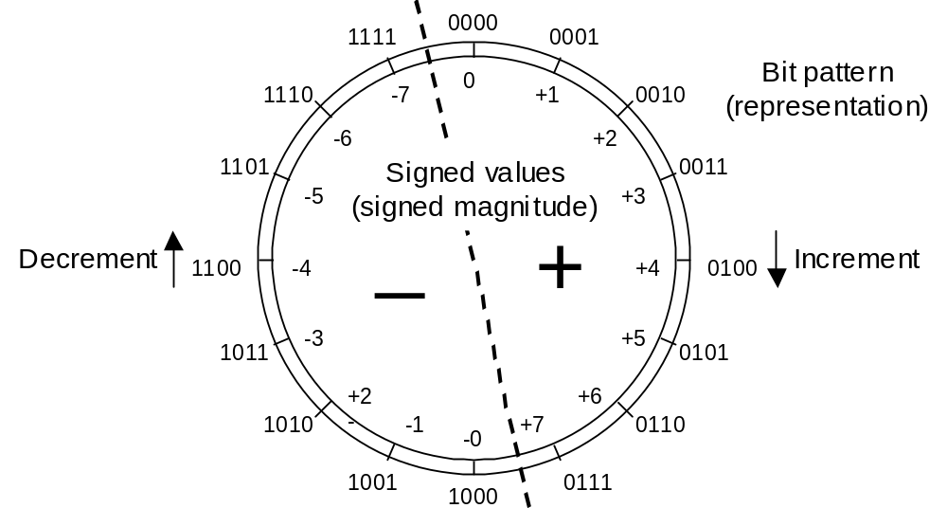
2.1 Signed-Magnitude Representation
-
Fig. 2.1 Four-bit signed-magnitude number representation system for integers.

Slide 25
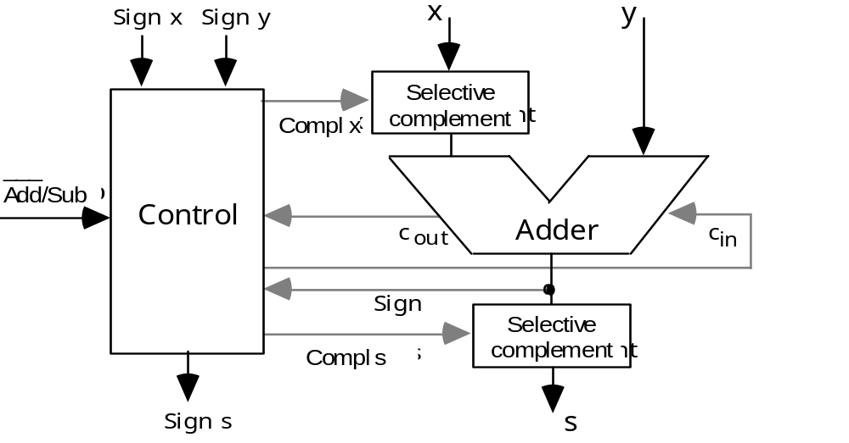
Signed-Magnitude Adder
Fig. 2.2 Adding signed-magnitude numbers using precomplementation and postcomplementation.

Slide 26
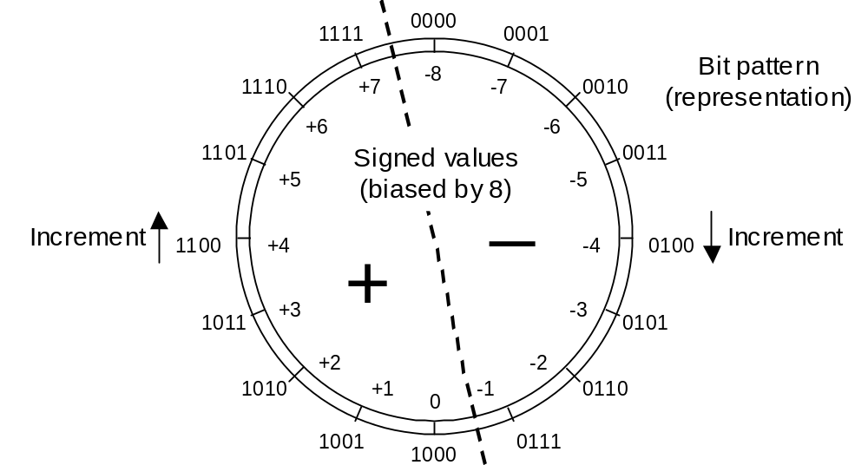
2.2 Biased Representations
Fig. 2.3 Four-bit biased integer number representation system with a bias of 8.

Slide 27
Arithmetic with Biased Numbers
Addition/subtraction of biased numbers
x + y + bias = (x + bias) + (y + bias) – bias
x – y + bias = (x + bias) – (y + bias) + bias
A power-of-2 (or 2ª – 1) bias simplifies addition/subtraction
Comparison of biased numbers:
Compare like ordinary unsigned numbers
find true difference by ordinary subtraction
We seldom perform arbitrary arithmetic on biased numbers
Main application: Exponent field of floating-point numbers

Slide 28
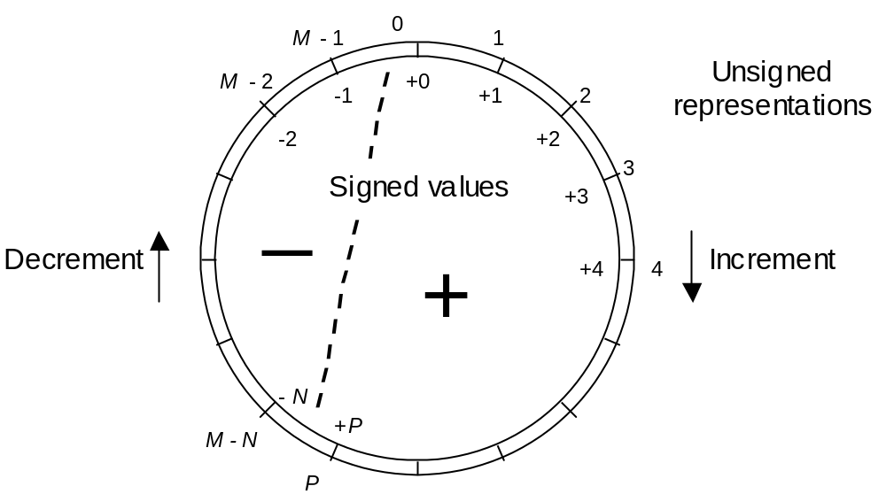
2.3 Complement Representations
Fig. 2.4 Complement representation of signed integers.

Slide 29
Arithmetic with Complement Representations
Table 2.1 Addition in a complement number system with complementation constant M and range [–N, +P]
–––––––––––––––––––––––––––––––––––––––––––––––––––––––––––
Desired Computation to be Correct result Overflow
operation performed mod M with no overflow condition
–––––––––––––––––––––––––––––––––––––––––––––––––––––––––––
(+x) + (+y) x + y x + y x + y > P
(+x) + (–y) x + (M – y) x – y if y ≤ x N/A
M – (y – x) if y > x
(–x) + (+y) (M – x) + y y – x if x ≤ y N/A
M – (x – y) if x > y
(–x) + (–y) (M – x) + (M – y) M – (x + y) x + y > N
–––––––––––––––––––––––––––––––––––––––––––––––––––––––––––

Slide 30
Example and Two Special Cases
Example -- complement system for fixed-point numbers:
Complementation constant M = 12.000
Fixed-point number range [–6.000, +5.999]
Represent –3.258 as 12.000 – 3.258 = 8.742
Auxiliary operations for complement representations
complementation or change of sign (computing M – x)
computations of residues mod M
Thus, M must be selected to simplify these operations
Two choices allow just this for fixed-point radix-r arithmetic
with k whole digits and l fractional digits
Radix complement M = r^{k}
Digit complement M = r^{k} – ulp (aka diminished radix compl)
ulp (unit in least position) stands for r^{−l}
Allows us to forget about l, even for nonintegers

Slide 31
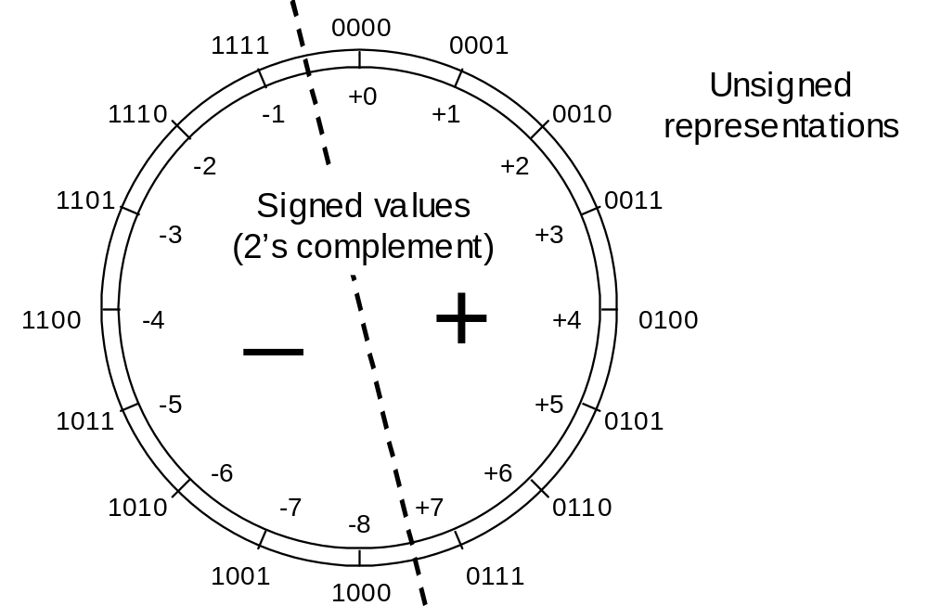
2.4 Two’s- and 1’s-Complement Numbers
Two’s complement = radix complement system for r = 2
M = 2^{k}
2^{k} – x = [(2^{k} – ulp) – x] + ulp
= x^{compl} + ulp
Range of representable numbers in with k whole bits:
from –2^{k–1} to 2^{k–1} – ulp
Fig. 2.5 A 4-bit 2’s-complement number representation system for integers.

Slide 32

One’s-Complement Number Representation
One’s complement = digit complement (diminished radix complement) system for r = 2
M = 2^{k} – ulp
(2^{k} – ulp) – x = x^{compl}
Range of representable numbers in with k whole bits:
from –2^{k–1} + ulp to 2^{k–1} – ulp
Fig. 2.6 A 4-bit 1’s-complement number representation system for integers.

Slide 33
Some Details for 2’s- and 1’s Complement
Range/precision extension for 2’s-complement numbers
. . . x_{k–1} x_{k–1} x_{k–1} x_{k–1} x_{k–2} . . . x₁ x₀ . x_{–1} x_{–2} . . . x_{–l} 0 0 0 . . .
← Sign extension → Sign LSD ← Extension →
bit
Range/precision extension for 1’s-complement numbers
. . . x_{k–1} x_{k–1} x_{k–1} x_{k–1} x_{k–2} . . . x₁ x₀ . x_{–1} x_{–2} . . . x_{–l} x_{k–1} x_{k–1} x_{k–1} . . .
← Sign extension → Sign LSD ← Extension →
bit
Mod-2^{k} operation needed in 2’s-complement arithmetic is trivial:
Simply drop the carry-out (subtract 2^{k} if result is 2^{k} or greater)
Mod-(2^{k} – ulp) operation needed in 1’s-complement arithmetic is done via end-around carry
(x + y) – (2^{k} – ulp) = (x – y – 2^{k}) + ulp Connect c_{out} to c_{in}

Slide 34
Which Complement System Is Better?
Table 2.2 Comparing radix- and digit-complement number representation systems
–––––––––––––––––––––––––––––––––––––––––––––––––––––––––––
Feature/Property Radix complement Digit complement
–––––––––––––––––––––––––––––––––––––––––––––––––––––––––––
Symmetry (P = N?) Possible for odd r Possible for even r
(radices of practical
interest are even)
Unique zero? Yes No, there are two 0s
Complementation Complement all digits Complement all digits
and add ulp
Mod-M addition Drop the carry-out End-around carry
–––––––––––––––––––––––––––––––––––––––––––––––––––––––––––

Slide 35
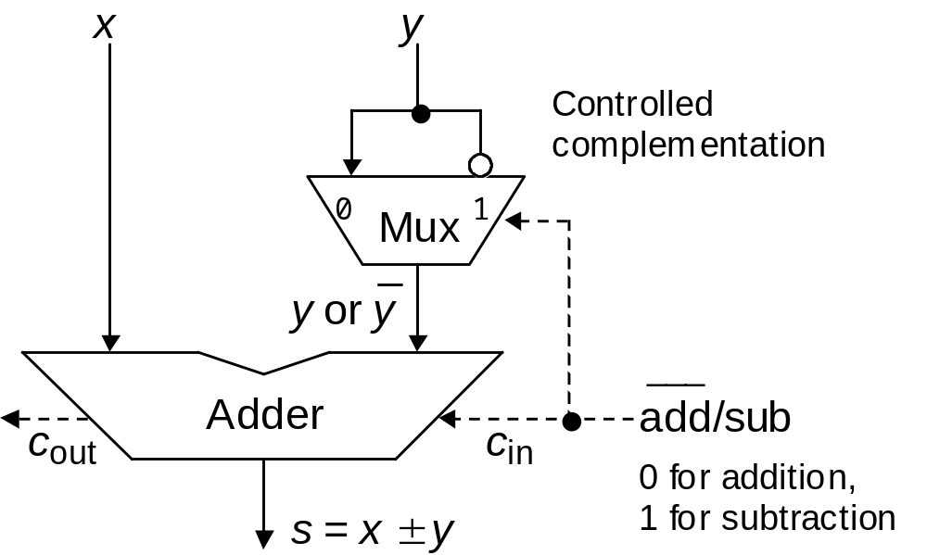
Why 2’s-Complement Is the Universal Choice
Can replace this mux with k XOR gates
Fig. 2.7 Adder/subtractor architecture for 2’s-complement numbers.

Slide 36
Signed-Magnitude vs 2’s-Complement
Signed-magnitude adder/subtractor is significantly more complex than a simple adder
Fig. 2.2
Two’s-complement adder/subtractor needs very little hardware other than a simple adder
Fig. 2.7

Slide 37
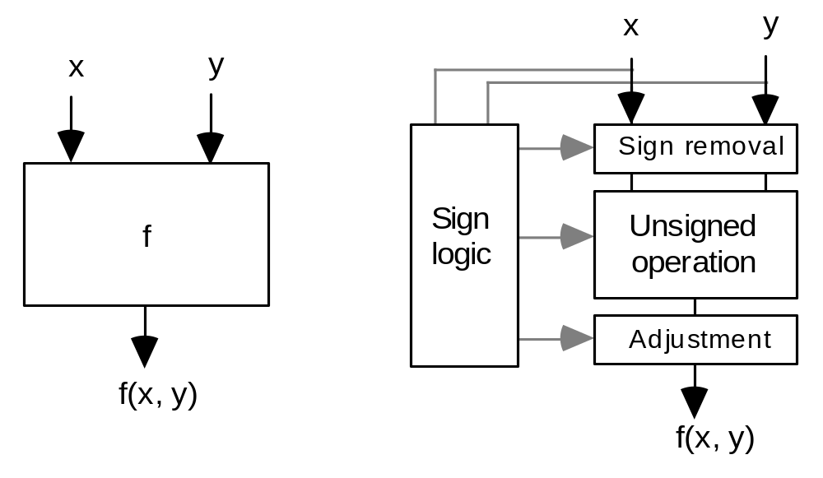
2.5 Direct and Indirect Signed Arithmetic
Fig. 2.8 Direct versus indirect operation on signed numbers.
Direct signed arithmetic is usually faster (not always)
Indirect signed arithmetic can be simpler (not always); allows sharing of signed/unsigned hardware when both operation types are needed

Slide 38
2.6 Using Signed Positions or Signed Digits
A key property of 2’s-complement numbers that facilitates direct signed arithmetic:
x = (1 0 1 0 0 1 1 0)_{two’s-compl}
–2⁷ 2⁶ 2⁵ 2⁴ 2³ 2² 2¹ 2⁰
–128 + 32 + 4 + 2 = –90
Check:
x = (1 0 1 0 0 1 1 0)_{two’s-compl}
–x = (0 1 0 1 1 0 1 0)_{two}
2⁷ 2⁶ 2⁵ 2⁴ 2³ 2² 2¹ 2⁰
64 + 16 + 8 + 2 = 90
Fig. 2.9 Interpreting a 2’s-complement number as having a negatively weighted most-significant digit.

Slide 39
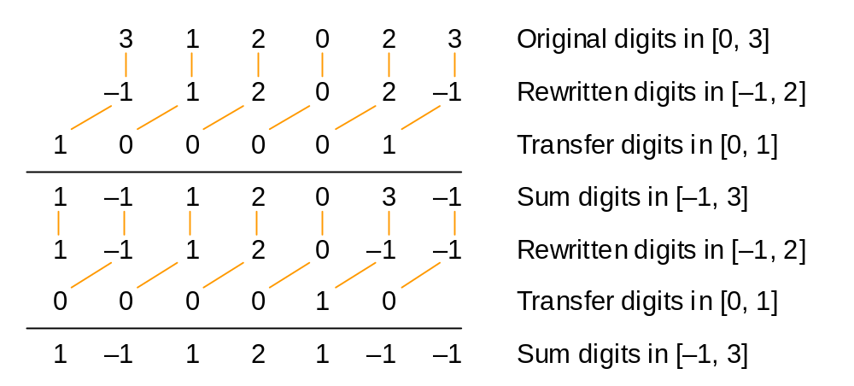
Associating a Sign with Each Digit
Signed-digit representation: Digit set [−α, β] instead of [0, r – 1]
Example: Radix-4 representation with digit set [−1, 2] rather than [0, 3]
Fig. 2.10 Converting a standard radix-4 integer to a radix-4 integer with the nonstandard digit set [–1, 2].

Slide 40
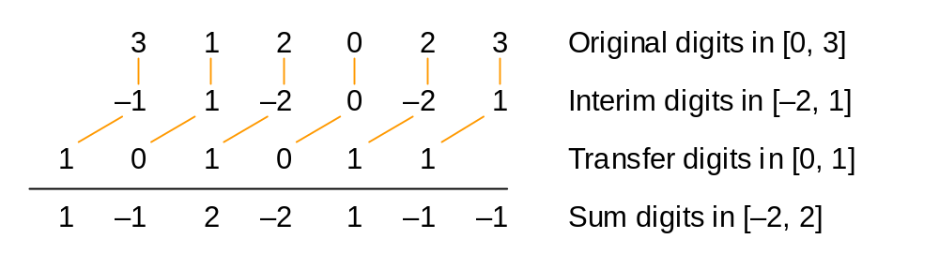
Redundant Signed-Digit Representations
Signed-digit representation: Digit set [−α, β], with ρ = α + β + 1 – r > 0
Example: Radix-4 representation with digit set [−2, 2]
Fig. 2.11 Converting a standard radix-4 integer to a radix-4 integer with the nonstandard digit set [–2, 2].
Here, the transfer does not propagate, so conversion is “carry-free”

Slide 41
3 Redundant Number Systems
Chapter Goals
Explore the advantages and drawbacks
of using more than r digit values in radix r
Chapter Highlights
Redundancy eliminates long carry chains
Redundancy takes many forms: trade-offs
Conversions between redundant
and nonredundant representations
Redundancy used for end values too?

Slide 42
Redundant Number Systems: Topics
Topics in This Chapter
3.1. Coping with the Carry Problem
3.2. Redundancy in Computer Arithmetic
3.3. Digit Sets and Digit-Set Conversions
3.4. Generalized Signed-Digit Numbers
3.5. Carry-Free Addition Algorithms
3.6. Conversions and Support Functions

Slide 43
3.1 Coping with the Carry Problem
Ways of dealing with the carry propagation problem:
1. Limit propagation to within a small number of bits (Chapters 3-4)
2. Detect end of propagation; don’t wait for worst case (Chapter 5)
3. Speed up propagation via lookahead etc. (Chapters 6-7)
4. Ideal: Eliminate carry propagation altogether! (Chapter 3)
5 7 8 2 4 9
6 2 9 3 8 9 Operand digits in [0, 9]
––––––––––––––––––––––––––––––––––
11 9 17 5 12 18 Position sums in [0, 18]
But how can we extend this beyond a single addition?
+

Slide 44
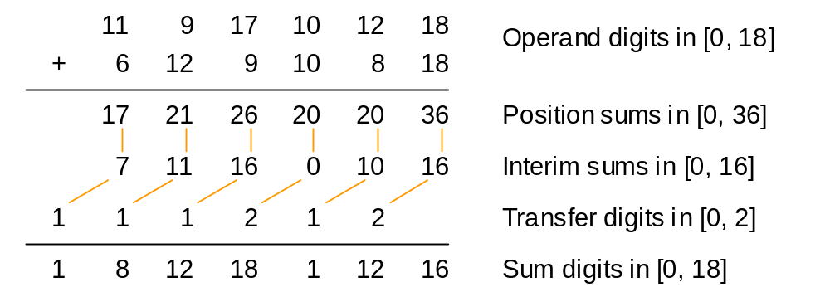
Addition of Redundant Numbers
Position sum decomposition [0, 36] = 10 × [0, 2] + [0, 16]
Absorption of transfer digit [0, 16] + [0, 2] = [0, 18]
Fig. 3.1 Adding radix-10 numbers with digit set [0, 18].

Slide 45
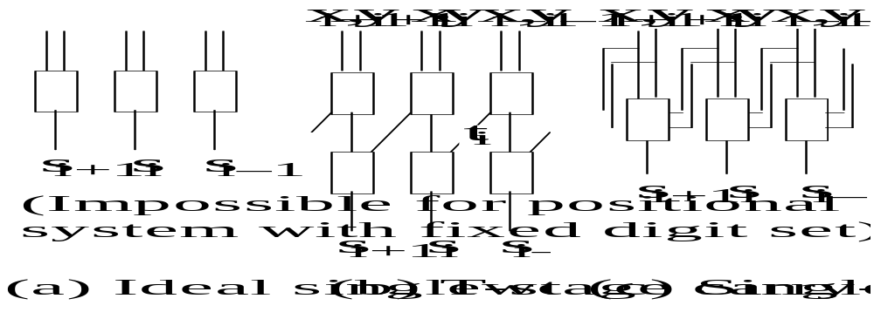
Meaning of Carry-Free Addition
Interim sum
at position i
Operand digits at position i
Transfer digit
into position i
Fig. 3.2 Ideal and practical carry-free addition schemes.

Slide 46
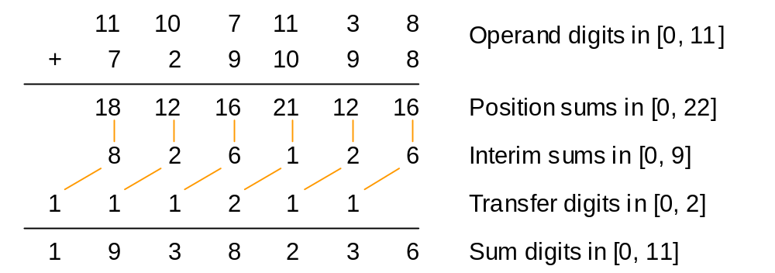
Redundancy Index
So, redundancy helps us achieve carry-free addition
But how much redundancy is actually needed? Is [0, 11] enough for r = 10?
Redundancy index ρ = α + β + 1 – r For example, 0 + 11 + 1 – 10 = 2
Fig. 3.3 Adding radix-10 numbers with digit set [0, 11].

Slide 47
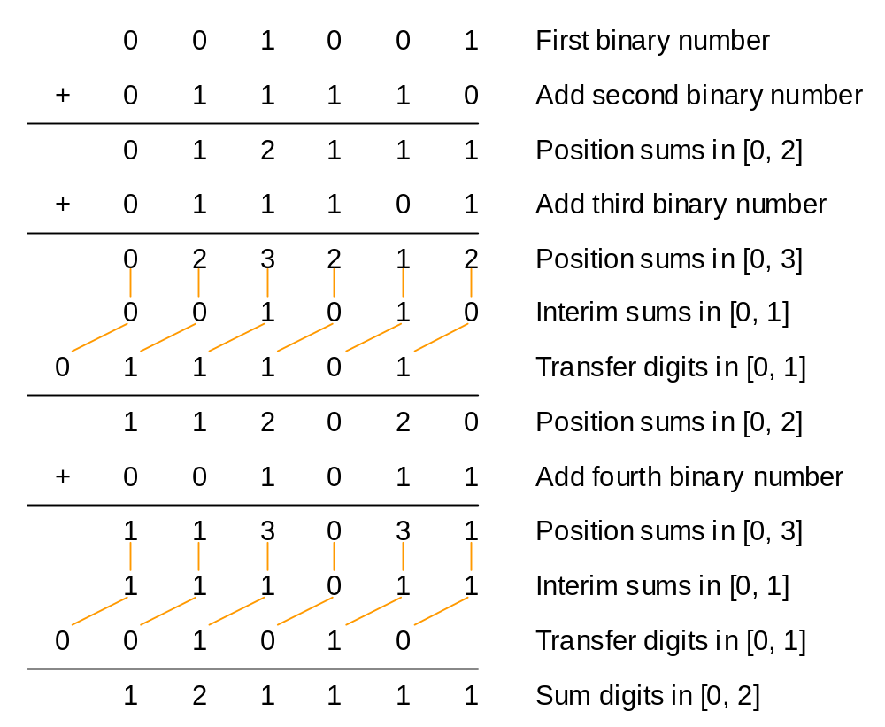
3.2 Redundancy in Computer Arithmetic
Oldest example of redundancy in computer arithmetic
is the stored-carry representation
(carry-save addition)
Fig. 3.4 Addition of four binary numbers, with the sum obtained in stored-carry form.

Slide 48
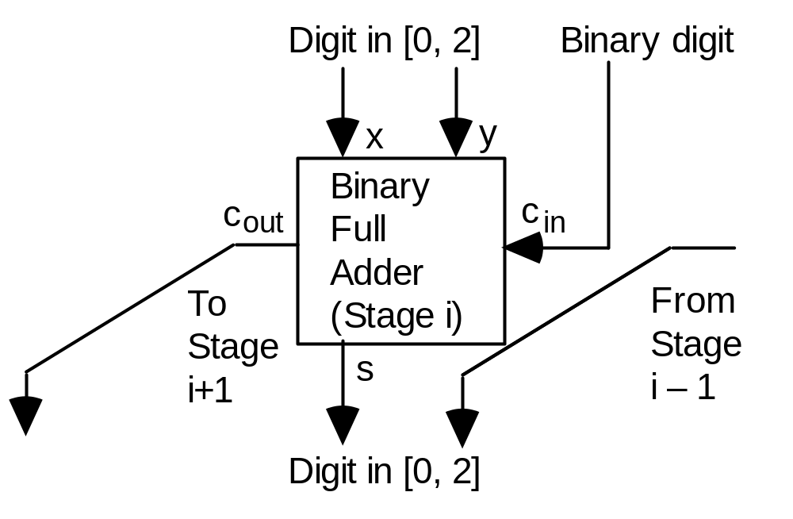
Hardware for Carry-Save Addition
Two-bit encoding for binary stored-carry digits used in this implementation:
0 represented as 0 0
1 represented as 0 1
or as 1 0
2 represented as 1 1
Because in carry-save addition, three binary numbers are reduced to two binary numbers, this process is sometimes referred to as 3-2 compression
Fig. 3.5 Using an array of independent binary full-adders to perform carry-save addition.

Slide 49
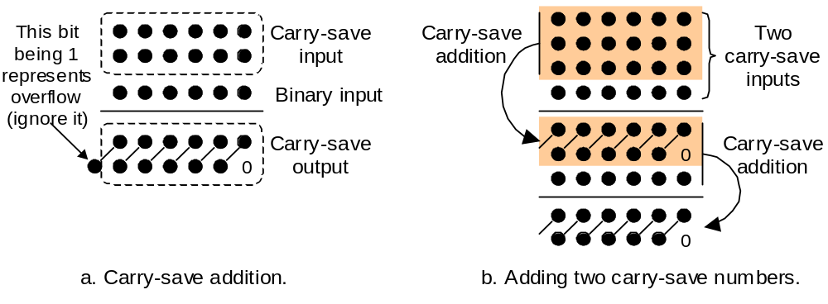
Carry-Save Addition in Dot Notation
4-to-2
reduction
3-to-2
reduction
Fig. 9.3 From text on computer architecture (Parhami, Oxford/2005)
We sometimes find it convenient to use an extended dot notation, with heavy dots (●) for posibits and hollow dots (○) for negabits
Eight-bit, 2’s-complement number ○ ● ● ● ● ● ● ●
Negative-radix number ○ ● ○ ● ○ ● ○ ●
BSD number with ⟨n, p⟩ encoding ○ ○ ○ ○ ○ ○ ○ ○
of the digit set [−1, 1] ● ● ● ● ● ● ● ●

Slide 50
Example for the Use of Extended Dot Notation
2’s-complement multiplicand ○ ● ● ● ● ● ● ●
2’s-complement multiplier ○ ● ● ● ● ● ● ●
○ ● ● ● ● ● ● ●
○ ● ● ● ● ● ● ●
○ ● ● ● ● ● ● ●
○ ● ● ● ● ● ● ●
○ ● ● ● ● ● ● ●
○ ● ● ● ● ● ● ●
○ ● ● ● ● ● ● ●
● ○ ○ ○ ○ ○ ○ ○
○ ● ● ● ● ● ● ● ● ● ● ● ● ● ● ●
Multiplication of 2’s-complement numbers
Option 1:
sign extension
Option 2: Baugh-Wooley method
−x
−x x x x x
−x
−y
1− x
−1 1− y

Slide 51
3.3 Digit Sets and Digit-Set Conversions
Example 3.1: Convert from digit set [0, 18] to [0, 9] in radix 10
11 9 17 10 12 18 18 = 10 (carry 1) + 8
11 9 17 10 13 8 13 = 10 (carry 1) + 3
11 9 17 11 3 8 11 = 10 (carry 1) + 1
11 9 18 1 3 8 18 = 10 (carry 1) + 8
11 10 8 1 3 8 10 = 10 (carry 1) + 0
12 0 8 1 3 8 12 = 10 (carry 1) + 2
1 2 0 8 1 3 8 Answer;
all digits in [0, 9]
Note: Conversion from redundant to nonredundant representation always involves carry propagation
Thus, the process is sequential and slow

Slide 52
Conversion from Carry-Save to Binary
Example 3.2: Convert from digit set [0, 2] to [0, 1] in radix 2
1 1 2 0 2 0 2 = 2 (carry 1) + 0
1 1 2 1 0 0 2 = 2 (carry 1) + 0
1 2 0 1 0 0 2 = 2 (carry 1) + 0
2 0 0 1 0 0 2 = 2 (carry 1) + 0
1 0 0 0 1 0 0 Answer;
all digits in [0, 1]
Another way: Decompose the carry-save number
into two numbers and add them:
1 1 1 0 1 0 1st number: sum bits
+ 0 0 1 0 1 0 2nd number: carry bits
––––––––––––––––––––––––––––––––––––––––
1 0 0 0 1 0 0 Sum

Slide 53
Conversion Between Redundant Digit Sets
Example 3.3: Convert from digit set [0, 18] to [−6, 5] in radix 10 (same as
Example 3.1, but with the target digit set signed and redundant)
11 9 17 10 12 18 18 = 20 (carry 2) – 2
11 9 17 10 14 −2 14 = 10 (carry 1) + 4
11 9 17 11 4 −2 11 = 10 (carry 1) + 1
11 9 18 1 4 −2 18 = 20 (carry 2) – 2
11 11 −2 1 4 −2 11 = 10 (carry 1) + 1
12 1 −2 1 4 −2 12 = 10 (carry 1) + 2
1 2 1 −2 1 4 −2 Answer;
all digits in [−6, 5]
On line 2, we could have written 14 = 20 (carry 2) – 6; this would have led to a different, but equivalent, representation
In general, several representations may exist for a redundant digit set

Slide 54
Carry-Free Conversion to a Redundant Digit Set
Example 3.4: Convert from digit set [0, 2] to [−1, 1] in radix 2 (same as
Example 3.2, but with the target digit set signed and redundant)
Carry-free conversion:
1 1 2 0 2 0 Carry-save number
–1 –1 0 0 0 0 Interim digits in [–1, 0]
1 1 1 0 1 0 Transfer digits in [0, 1]
––––––––––––––––––––––––––––––––––––––––
1 0 0 0 1 0 0 Answer;
all digits in [–1, 1]
We rewrite 2 as 2 (carry 1) + 0, and 1 as 2 (carry 1) – 1
A carry of 1 is always absorbed by the interim digit that is in {−1, 0}

Slide 55
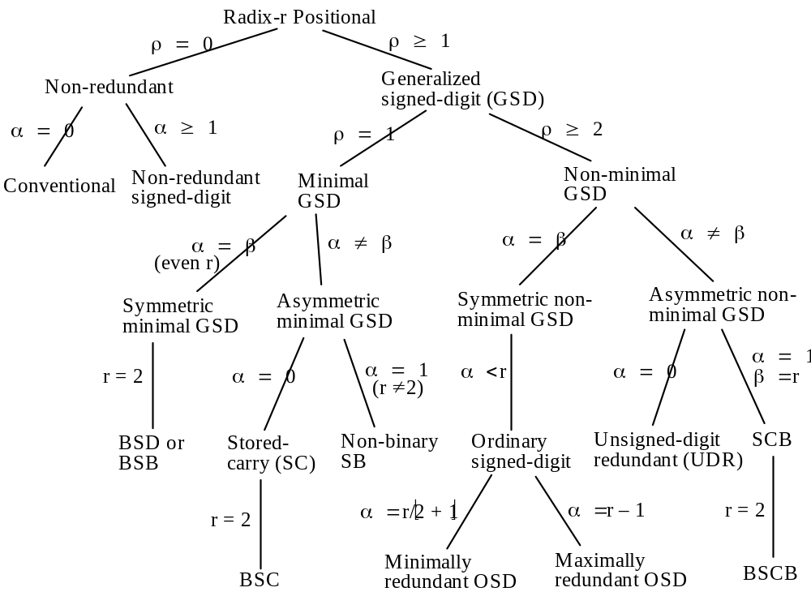
3.4 Generalized Signed-Digit Numbers
Radix r
Digit set [–α, β]
Requirement
α + β + 1 ≥ r
Redundancy index
ρ = α + β + 1 – r
Fig. 3.6
A taxonomy of redundant and non-redundant positional number systems.

Slide 56
Encodings for Signed Digits
x_{i} 1 –1 0 –1 0 BSD representation of +6
⟨s, v⟩ 01 11 00 11 00 Sign and value encoding
2’s-compl 01 10 00 10 00 2-bit 2’s-complement
⟨n, p⟩ 01 10 00 10 00 Negative & positive flags
⟨n, z, p⟩ 001 100 010 100 010 1-out-of-3 encoding
Fig. 3.7 Four encodings for the BSD digit set [–1, 1].
Two of the encodings above can be shown in extended dot notation
(● = posibit, ○ = negabit, ■ = doublebit, □ = negadoublebit)
2’s-compl □ □ □ □ □
● ● ● ● ●
⟨n, p⟩ ○ ○ ○ ○ ○
● ● ● ● ●
These two encodings are nearly equivalent (left-shift the doublebits)

Slide 57
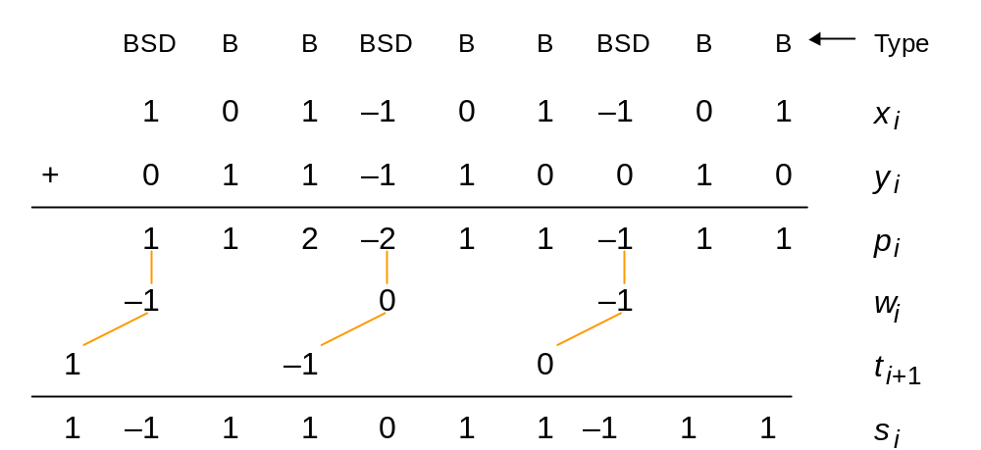
Hybrid Signed-Digit Numbers
Radix-8 GSD with digit set [−4,7]
Fig. 3.8 Example of addition for hybrid signed-digit numbers.
The hybrid-redundant representation above in extended dot notation:
⟨n, p⟩ -encoded ○ ● ● ○ ● ● ○ ● ● Nonredundant
binary signed digit ● ● ● binary positions

Slide 58
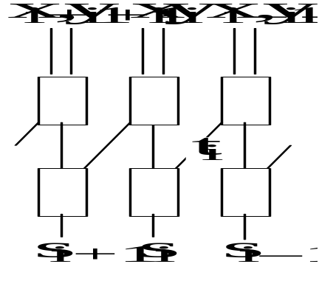
3.5 Carry-Free Addition Algorithms
Carry-free addition of GSD numbers
Compute the position sums p_{i} = x_{i} + y_{i}
Divide p_{i} into a transfer t_{i+1} and interim sum w_{i} = p_{i} – rt_{i+1}
Add incoming transfers to get the sum digits s_{i} = w_{i} + t_{i}
w_{i}
If the transfer digits t_{i} are in [–λ, μ], we must have:
–α + λ ≤ p_{i} – rt_{i+1} ≤ β – μ
interim sum
Smallest interim sum Largest interim sum
if a transfer of –λ if a transfer of μ
is to be absorbable is to be absorbable
These
constraints
lead to:
λ ≥ α / (r – 1)
μ ≥ β / (r – 1)

Slide 59
Is Carry-Free Addition Always Applicable?
No: It requires one of the following two conditions
a. r > 2, ρ ≥ 3
b. r > 2, ρ = 2, α ≠ 1, β ≠ 1 e.g., not [−1, 10] in radix 10
In other words, it is inapplicable for
r = 2 Perhaps most useful case
ρ = 1 e.g., carry-save
ρ = 2 with α = 1 or β = 1 e.g., carry/borrow-save
BSD fails on at least two criteria!
Fortunately, in the latter cases, a limited-carry addition algorithm is always applicable

Slide 60
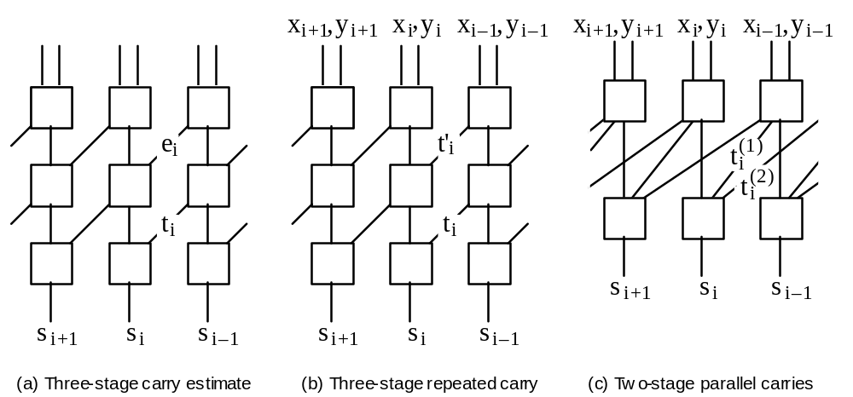
Limited-Carry Addition
Example: BSD addition 1 1 1 ⁻1
0 1 0 ⁻1
1
⁻1
Estimate, or
early warning
Fig. 3.11 Example of addition for hybrid signed-digit numbers.

Slide 61
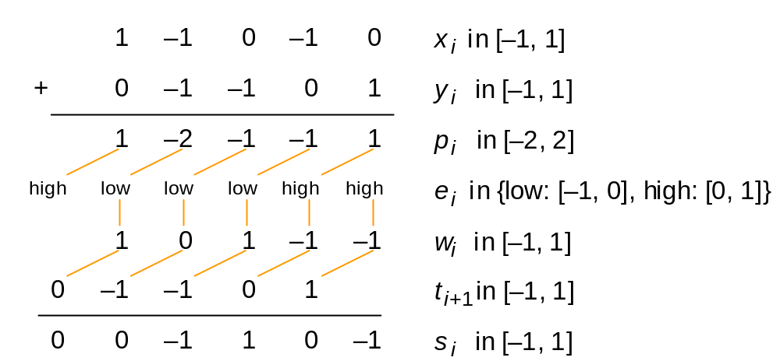
Limited-Carry BSD Addition
Fig. 3.12 Limited-carry addition of radix-2 numbers with digit set [–1, 1] using carry estimates. A position sum –1 is kept intact when the incoming transfer is in [0, 1], whereas it is rewritten as 1 with a carry of –1 for incoming transfer in [–1, 0]. This guarantees that t_{i} ≠ w_{i} and thus –1 ≤ s_{i} ≤ 1.

Slide 62
3.6 Conversions and Support Functions
Example 3.10: Conversion from/to BSD to/from standard binary
1 −1 0 −1 0 BSD representation of +6
1 0 0 0 0 Positive part
0 1 0 1 0 Negative part
0 0 1 1 0 Difference =
Conversion result
The negative and positive parts above are particularly easy to obtain
if the BSD number has the ⟨n, p⟩ encoding
Conversion from redundant to nonredundant representation always requires full carry propagation
Conversion from nonredundant to redundant is often trivial

Slide 63
Other Arithmetic Support Functions
Zero test: Zero has a unique code under some conditions
Sign test: Needs carry propagation
Overflow: May be real or apparent (result may be representable)
x_{k–1} x_{k–2} . . . x₁ x₀ k-digit GSD operands
+ y_{k–1} y_{k–2} . . . y₁ y₀
–––––––––––––––––––––––––––
p_{k–1} p_{k–2} . . . p₁ p₀ Position sums
| | | |
w_{k–1} w_{k–2} . . . w₁ w₀ Interim sum digits
⁄ ⁄ ⁄ ⁄
t_{k} t_{k–1} . . . t₂ t₁ Transfer digits
–––––––––––––––––––––––––––
s_{k–1} s_{k–2} . . . s₁ s₀ k-digit apparent sum
Fig. 3.16 Overflow and its detection in GSD arithmetic.

Slide 64
4 Residue Number Systems
Chapter Goals
Study a way of encoding large numbers
as a collection of smaller numbers
to simplify and speed up some operations
Chapter Highlights
Moduli, range, arithmetic operations
Many sets of moduli possible: tradeoffs
Conversions between RNS and binary
The Chinese remainder theorem
Why are RNS applications limited?

Slide 65
Residue Number Systems: Topics
Topics in This Chapter
4.1. RNS Representation and Arithmetic
4.2. Choosing the RNS Moduli
4.3. Encoding and Decoding of Numbers
4.4. Difficult RNS Arithmetic Operations
4.5. Redundant RNS Representations
4.6. Limits of Fast Arithmetic in RNS

Slide 66
4.1 RNS Representations and Arithmetic
Chinese puzzle, 1500 years ago:
What number has the remainders of 2, 3, and 2
when divided by 7, 5, and 3, respectively?
Residues (akin to digits in positional systems) uniquely identify the number, hence they constitute a representation
Pairwise relatively prime moduli: m_{k–1} > . . . > m₁ > m₀
The residue x_{i} of x wrt the ith modulus m_{i} (similar to a digit):
x_{i} = x mod m_{i} = ⟨x⟩_{mi}
RNS representation contains a list of k residues or digits:
x = (2 | 3 | 2)_{RNS(7|5|3)}
Default RNS for this chapter: RNS(8 | 7 | 5 | 3)

Slide 67
RNS Dynamic Range
Product M of the k pairwise relatively prime moduli is the dynamic range
M = m_{k–1} × . . . × m₁ × m₀
For RNS(8 | 7 | 5 | 3), M = 8 × 7 × 5 × 3 = 840
Negative numbers: Complement relative to M
⟨–x⟩_{mi} = ⟨M – x⟩_{mi}
21 = (5 | 0 | 1 | 0)_{RNS}
–21 = (8 – 5 | 0 | 5 – 1 | 0)_{RNS} = (3 | 0 | 4 | 0)_{RNS}
We can take the range of RNS(8|7|5|3) to be [−420, 419] or any other set of 840 consecutive integers
Here are some example numbers in our default RNS(8 | 7 | 5 | 3):
(0 | 0 | 0 | 0)_{RNS} Represents 0 or 840 or . . .
(1 | 1 | 1 | 1)_{RNS} Represents 1 or 841 or . . .
(2 | 2 | 2 | 2)_{RNS} Represents 2 or 842 or . . .
(0 | 1 | 3 | 2)_{RNS} Represents 8 or 848 or . . .
(5 | 0 | 1 | 0)_{RNS} Represents 21 or 861 or . . .
(0 | 1 | 4 | 1)_{RNS} Represents 64 or 904 or . . .
(2 | 0 | 0 | 2)_{RNS} Represents –70 or 770 or . . .
(7 | 6 | 4 | 2)_{RNS} Represents –1 or 839 or . . .

Slide 68
RNS as Weighted Representation
For RNS(8 | 7 | 5 | 3), the weights of the 4 positions are:
105 120 336 280
Example: (1 | 2 | 4 | 0)_{RNS} represents the number
⟨105×1 + 120×2 + 336×4 + 280×0⟩₈₄₀ = ⟨1689⟩₈₄₀ = 9
For RNS(7 | 5 | 3), the weights of the 3 positions are:
15 21 70
Example -- Chinese puzzle: (2 | 3 | 2)_{RNS(7|5|3)} represents the number
⟨15 × 2 + 21 × 3 + 70 × 2⟩₁₀₅ = ⟨233⟩₁₀₅ = 23
We will see later how the weights can be determined for a given RNS

Slide 69
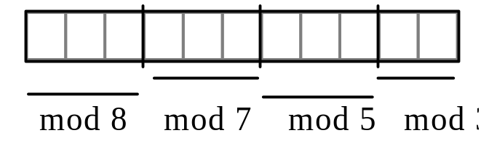
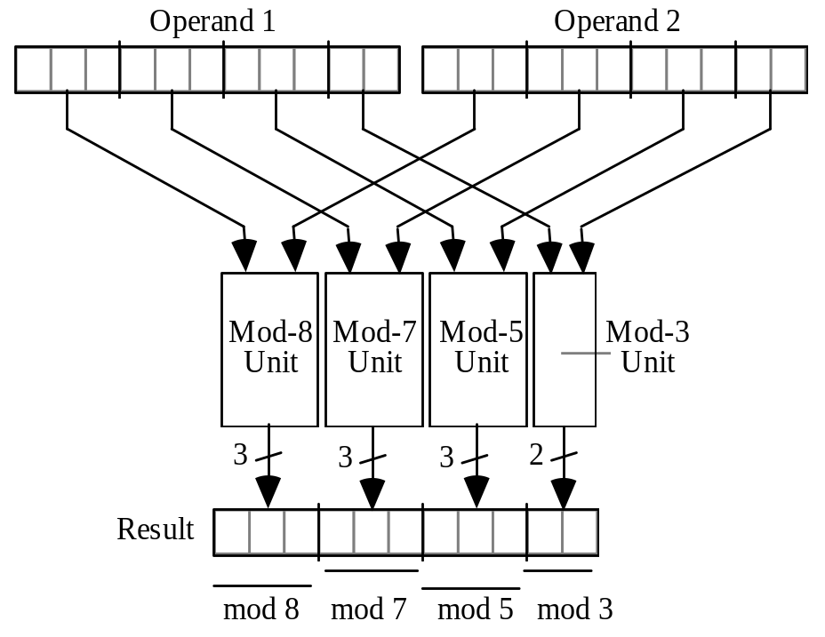
RNS Encoding and Arithmetic Operations
Fig. 4.1 Binary-coded format for RNS(8 | 7 | 5 | 3).
Fig. 4.2 The structure of an adder, subtractor, or multiplier for RNS(8|7|5|3).
Arithmetic in RNS(8 | 7 | 5 | 3)
(5 | 5 | 0 | 2)_{RNS} Represents x = +5
(7 | 6 | 4 | 2)_{RNS} Represents y = –1
(4 | 4 | 4 | 1)_{RNS} x + y : ⟨5 + 7⟩₈ = 4, ⟨5 + 6⟩₇ = 4, etc.
(6 | 6 | 1 | 0)_{RNS} x – y : ⟨5 – 7⟩₈ = 6, ⟨5 – 6⟩₇ = 6, etc.
(alternatively, find –y and add to x)
(3 | 2 | 0 | 1)_{RNS} x × y : ⟨5 × 7⟩₈ = 3, ⟨5 × 6⟩₇ = 2, etc.

Slide 70
4.2 Choosing the RNS Moduli
Target range for our RNS: Decimal values [0, 100 000]
Strategy 1: To minimize the largest modulus, and thus ensure high-speed arithmetic, pick prime numbers in sequence
Pick m₀ = 2, m₁ = 3, m₂ = 5, etc. After adding m₅ = 13:
RNS(13 | 11 | 7 | 5 | 3 | 2) M = 30 030 Inadequate
RNS(17 | 13 | 11 | 7 | 5 | 3 | 2) M = 510 510 Too large
RNS(17 | 13 | 11 | 7 | 3 | 2) M = 102 102 Just right!
5 + 4 + 4 + 3 + 2 + 1 = 19 bits
Fine tuning: Combine pairs of moduli 2 & 13 (26) and 3 & 7 (21)
RNS(26 | 21 | 17 | 11) M = 102 102

Slide 71
An Improved Strategy
Target range for our RNS: Decimal values [0, 100 000]
Strategy 2: Improve strategy 1 by including powers of smaller primes before proceeding to the next larger prime
RNS(2² | 3) M = 12
RNS(3² | 2³ | 7 | 5) M = 2520
RNS(11 | 3² | 2³ | 7 | 5) M = 27 720
RNS(13 | 11 | 3² | 2³ | 7 | 5) M = 360 360
(remove one 3, combine 3 & 5)
RNS(15 | 13 | 11 | 2³ | 7) M = 120 120
4 + 4 + 4 + 3 + 3 = 18 bits
Fine tuning: Maximize the size of the even modulus within the 4-bit limit
RNS(2⁴ | 13 | 11 | 3² | 7 | 5) M = 720 720 Too large
We can now remove 5 or 7; not an improvement in this example

Slide 72
Low-Cost RNS Moduli
Target range for our RNS: Decimal values [0, 100 000]
Strategy 3: To simplify the modular reduction (mod m_{i}) operations, choose only moduli of the forms 2ª or 2ª – 1, aka “low-cost moduli”
RNS(2^{ak–1} | 2^{ak–2} – 1 | . . . | 2^{a1} – 1 | 2^{a0} – 1)
We can have only one even modulus
2^{ai} – 1 and 2^{aj} – 1 are relatively prime iff a_{i} and a_{j} are relatively prime
RNS(2³ | 2³–1 | 2²–1) basis: 3, 2 M = 168
RNS(2⁴ | 2⁴–1 | 2³–1) basis: 4, 3 M = 1680
RNS(2⁵ | 2⁵–1 | 2³–1 | 2²–1) basis: 5, 3, 2 M = 20 832
RNS(2⁵ | 2⁵–1 | 2⁴–1 | 2³–1) basis: 5, 4, 3 M = 104 160
Comparison
RNS(15 | 13 | 11 | 2³ | 7) 18 bits M = 120 120
RNS(2⁵ | 2⁵–1 | 2⁴–1 | 2³–1) 17 bits M = 104 160

Slide 73
4.3 Encoding and Decoding of Numbers
Conversion from binary/decimal to RNS
Table 4.1 Residues of the first 10 powers of 2
–––––––––––––––––––––––––––––
i 2^{i} ⟨2^{i}⟩₇ ⟨2^{i}⟩₅ ⟨2^{i}⟩₃
–––––––––––––––––––––––––––––
0 1 1 1 1
1 2 2 2 2
2 4 4 4 1
3 8 1 3 2
4 16 2 1 1
5 32 4 2 2
6 64 1 4 1
7 128 2 3 2
8 256 4 1 1
9 512 1 2 2
–––––––––––––––––––––––––––––
Example 4.1: Represent the number y = (1010 0100)_{two} = (164)_{ten} in RNS(8 | 7 | 5 | 3)
The mod-8 residue is easy to find
x₃ = ⟨y⟩₈ = (100)_{two} = 4
We have y = 2⁷+2⁵+2²; thus
x₂ = ⟨y⟩₇ = ⟨2 + 4 + 4⟩₇ = 3
x₁ = ⟨y⟩₅ = ⟨3 + 2 + 4⟩₅ = 4
x₀ = ⟨y⟩₃ = ⟨2 + 2 + 1⟩₃ = 2

Slide 74
Conversion from RNS to Mixed-Radix Form
MRS(m_{k–1} | . . . | m₂ | m₁ | m₀) is a k-digit positional system with weights
m_{k–2}...m₂m₁m₀ . . . m₂m₁m₀ m₁m₀ m₀ 1
and digit sets
[0, m_{k–1}–1] . . . [0,m₃–1] [0,m₂–1] [0,m₁–1] [0,m₀–1]
Example: (0 | 3 | 1 | 0)_{MRS(8|7|5|3)} = 0×105 + 3×15 + 1×3 + 0×1 = 48
RNS-to-MRS conversion problem:
y = (x_{k–1} | . . . | x₂ | x₁ | x₀)_{RNS} = (z_{k–1} | . . . | z₂ | z₁ | z₀)_{MRS}
MRS representation allows magnitude comparison and sign detection
Example: 48 versus 45
(0 | 6 | 3 | 0)_{RNS} vs (5 | 3 | 0 | 0)_{RNS}
(000 | 110 | 011 | 00)_{RNS} vs (101 | 011 | 000 | 00)_{RNS}
Equivalent mixed-radix representations
(0 | 3 | 1 | 0)_{MRS} vs (0 | 3 | 0 | 0)_{MRS}
(000 | 011 | 001 | 00)_{MRS} vs (000 | 011 | 000 | 00)_{MRS}

Slide 75
Conversion from RNS to Binary/Decimal
Theorem 4.1 (The Chinese remainder theorem)
x = (x_{k–1} | . . . | x₂ | x₁ | x₀)_{RNS} = ⟨ ∑_{i} M_{i} ⟨α_{i} x_{i}⟩_{mi} ⟩_{M}
where M_{i} = M/m_{i} and α_{i} = ⟨M_{i} ^{–1}⟩_{mi} (multiplicative inverse of M_{i} wrt m_{i})
Implementing CRT-based RNS-to-binary conversion
x = ⟨ ∑_{i} M_{i} ⟨α_{i} x_{i}⟩_{mi} ⟩_{M} = ⟨ ∑_{i} f_{i}(x_{i}) ⟩_{M}
We can use a table to store the f_{i} values –- ∑_{i} m_{i} entries
Table 4.2 Values needed in applying the Chinese remainder theorem to RNS(8 | 7 | 5 | 3)
––––––––––––––––––––––––––––––
i m_{i} x_{i} ⟨M_{i} ⟨α_{i} x_{i}⟩_{mi}⟩_{M}
––––––––––––––––––––––––––––––
3 8 0 0
1 105
2 210
3 315
. .
. .
. .

Slide 76
Intuitive Justification for CRT
Puzzle: What number has the remainders of 2, 3, and 2
when divided by the numbers 7, 5, and 3, respectively?
x = (2 | 3 | 2)_{RNS(7|5|3)} = (?)_{ten}
(1 | 0 | 0)_{RNS(7|5|3)} = multiple of 15 that is 1 mod 7 = 15
(0 | 1 | 0)_{RNS(7|5|3)} = multiple of 21 that is 1 mod 5 = 21
(0 | 0 | 1)_{RNS(7|5|3)} = multiple of 35 that is 1 mod 3 = 70
(2 | 3 | 2)_{RNS(7|5|3)} = (2 | 0 | 0) + (0 | 3 | 0) + (0 | 0 | 2)
= 2 × (1 | 0 | 0) + 3 × (0 | 1 | 0) + 2 × (0 | 0 | 1)
= 2 × 15 + 3 × 21 + 2 × 70
= 30 + 63 + 140
= 233 = 23 mod 105
Therefore, x = (23)_{ten}

Slide 77
4.4 Difficult RNS Arithmetic Operations
Sign test and magnitude comparison are difficult
Example: Of the following RNS(8 | 7 | 5 | 3) numbers:
Which, if any, are negative?
Which is the largest?
Which is the smallest?
Assume a range of [–420, 419]
a = (0 | 1 | 3 | 2)_{RNS}
b = (0 | 1 | 4 | 1)_{RNS}
c = (0 | 6 | 2 | 1)_{RNS}
d = (2 | 0 | 0 | 2)_{RNS}
e = (5 | 0 | 1 | 0)_{RNS}
f = (7 | 6 | 4 | 2)_{RNS}
Answers:
d < c < f < a < e < b
–70 < –8 < –1 < 8 < 21 < 64

Slide 78
Approximate CRT Decoding
Theorem 4.1 (The Chinese remainder theorem, scaled version)
Divide both sides of CRT equality by M to get scaled version of x in [0, 1)
x = (x_{k–1} | . . . | x₂ | x₁ | x₀)_{RNS} = ⟨ ∑_{i} M_{i} ⟨α_{i} x_{i}⟩_{mi} ⟩_{M}
x/M = ⟨ ∑_{i} ⟨α_{i} x_{i}⟩_{mi} / m_{i} ⟩₁ = ⟨ ∑_{i} g_{i}(x_{i}) ⟩₁
where mod-1 summation implies that we discard the integer parts
Errors can be estimated and kept in check for the particular application
Table 4.3 Values needed in applying the approximate Chinese remainder theorem decoding to RNS(8 | 7 | 5 | 3)
––––––––––––––––––––––––––––––
i m_{i} x_{i} ⟨α_{i} x_{i}⟩_{mi} / m_{i}
––––––––––––––––––––––––––––––
3 8 0 .0000
1 .1250
2 .2500
3 .3750
. .
. .
. .

Slide 79
General RNS Division
General RNS division, as opposed to division by one of the moduli
(aka scaling), is difficult; hence, use of RNS is unlikely to be effective
when an application requires many divisions
Scheme proposed in 1994 PhD thesis of Ching-Yu Hung (UCSB):
Use an algorithm that has built-in tolerance to imprecision, and apply
the approximate CRT decoding to choose quotient digits
Example –– SRT algorithm (s is the partial remainder)
s < 0 quotient digit = –1
s ≅ 0 quotient digit = 0
s > 0 quotient digit = 1
The BSD quotient can be converted to RNS on the fly

Slide 80
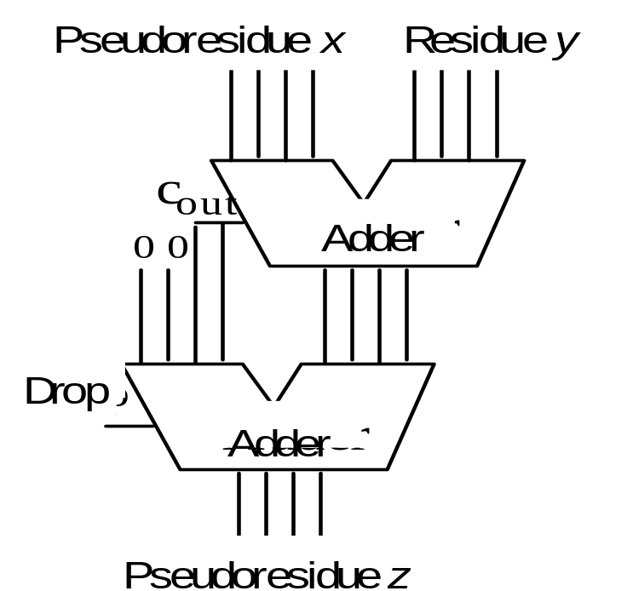
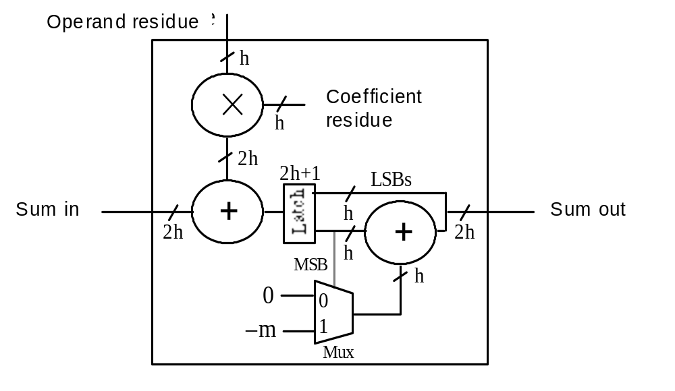
4.5 Redundant RNS Representations
[0, 15]
[0, 12]
[0, 15]
[0, 11]
if c_{out} = 1
[0, 15]
Fig. 4.3 Modulo-13 adder, with the output and one input being pseudoresidues in [0, 15].
Fig. 4.4 A modulo-m multiply-add cell that accumulates the sum into a double-length redundant pseudoresidue.

Slide 81
4.6 Limits of Fast Arithmetic in RNS
Known results from number theory
Theorem 4.2: The ith prime p_{i} is asymptotically i ln i
Theorem 4.3: The number of primes in [1, n] is asymptotically n / ln n
Theorem 4.4: The product of all primes in [1, n] is asymptotically e^{n}
Implications to speed of arithmetic in RNS
Theorem 4.5: It is possible to represent all k-bit binary numbers
in RNS with O(k / log k) moduli such that the largest modulus
has O(log k) bits
That is, with fast log-time adders, addition needs O(log log k) time

Slide 82
Limits for Low-Cost RNS
Known results from number theory
Theorem 4.6: The numbers 2ª – 1 and 2^{b} – 1 are relatively prime
iff a and b are relatively prime
Theorem 4.7: The sum of the first i primes is asymptotically O(i² ln i)
Implications to speed of arithmetic in low-cost RNS
Theorem 4.8: It is possible to represent all k-bit binary numbers in
RNS with O((k / log k)^{1/2}) low-cost moduli of the form 2ª – 1
such that the largest modulus has O((k log k)^{1/2}) bits
Because a fast adder needs O(log k) time, asymptotically,
low-cost RNS offers little speed advantage over standard binary

Slide 83
Disclaimer About RNS Representations
RNS representations are sometimes referred to as “carry-free”
Positional representation does not support totally carry-free addition; but it appears that RNS does allow digitwise arithmetic
However . . . even though each RNS digit is processed independently (for +, –, ×), the size of the digit set is dependent on the desired range
(grows at least double-logarithmically with the range M, or logarithmically with the word width k in the binary representation of the same range)

